Slide 1

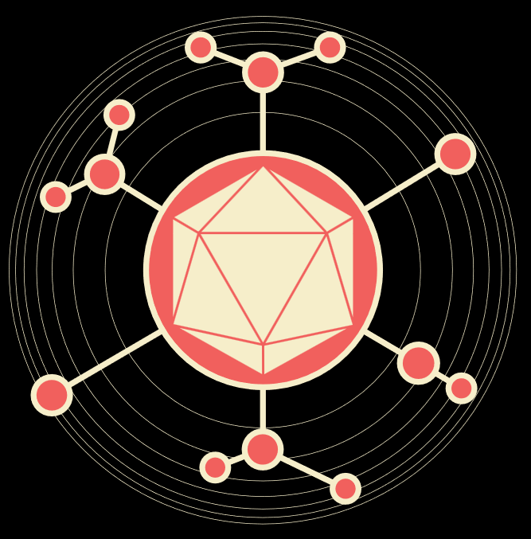
Sample collection and extraction
ARTIC Network Train the Trainer - August 2022
ARTIC TRAIN 01AUG22 Yasmin Goodfellow

Slide 2

Objectives
Safety
Collection requirements
RNA from samples
Options for RNA extraction

Slide 3


Safety
-Do not accept damaged samples!
-Live samples require special handling (CL3 ect)
-Received samples MUST BE INACTIVATED
-Extractions should be handled BSCII as an additional safety measure
-Waste management
Notes:
Damaged or leaking tubes are not only a health hazard but also a significant contamination route
Live samples pose significant risk to anyone handling
Most clinical samples will be stored in a passive lysis buffer. Ensure this with clinical partners
Extractions must be performed under BSC II conditions to prevent contamination to samples and to the user and surrounding environment
Waste management also needs to be considered carefully (bagging tips etc)

Slide 4

Collection requirements
-Known quality/CT, RLU
-Complete patient metadata - traceability
-Minimise sample collection turnaround
-Appropriate storage before collection
-Sample anonymisation
-Assign internal ID
Notes:
Firstly, there are certain factors to consider before carrying samples forward for seq.
One of these is the CT value of the sample which refers to the amount of viral genetic material within each sample. CT refers to Cycle Threshold…..
Secondly, we need to have the individuals complete metadata trail, which allows for full traceability and continuity of information throughout the seq pipeline…includes patient name, age, Sex, location and so forth….
We also need to consider sample turnaround time, that is, the time from sample collection to sample storage and processing…This isn’t so critical if the sample has been stored within the cold chain, but is a consideration when generating sequence data in real time.
It is also important to anonymise all samples for patient confidentiality; a unique ID number must first be generated and logged against original patient info for tracing throughout the pipeline-have to tie in at the end….(google sheets)
Appropriate storage (user requirements may differ)

Slide 5
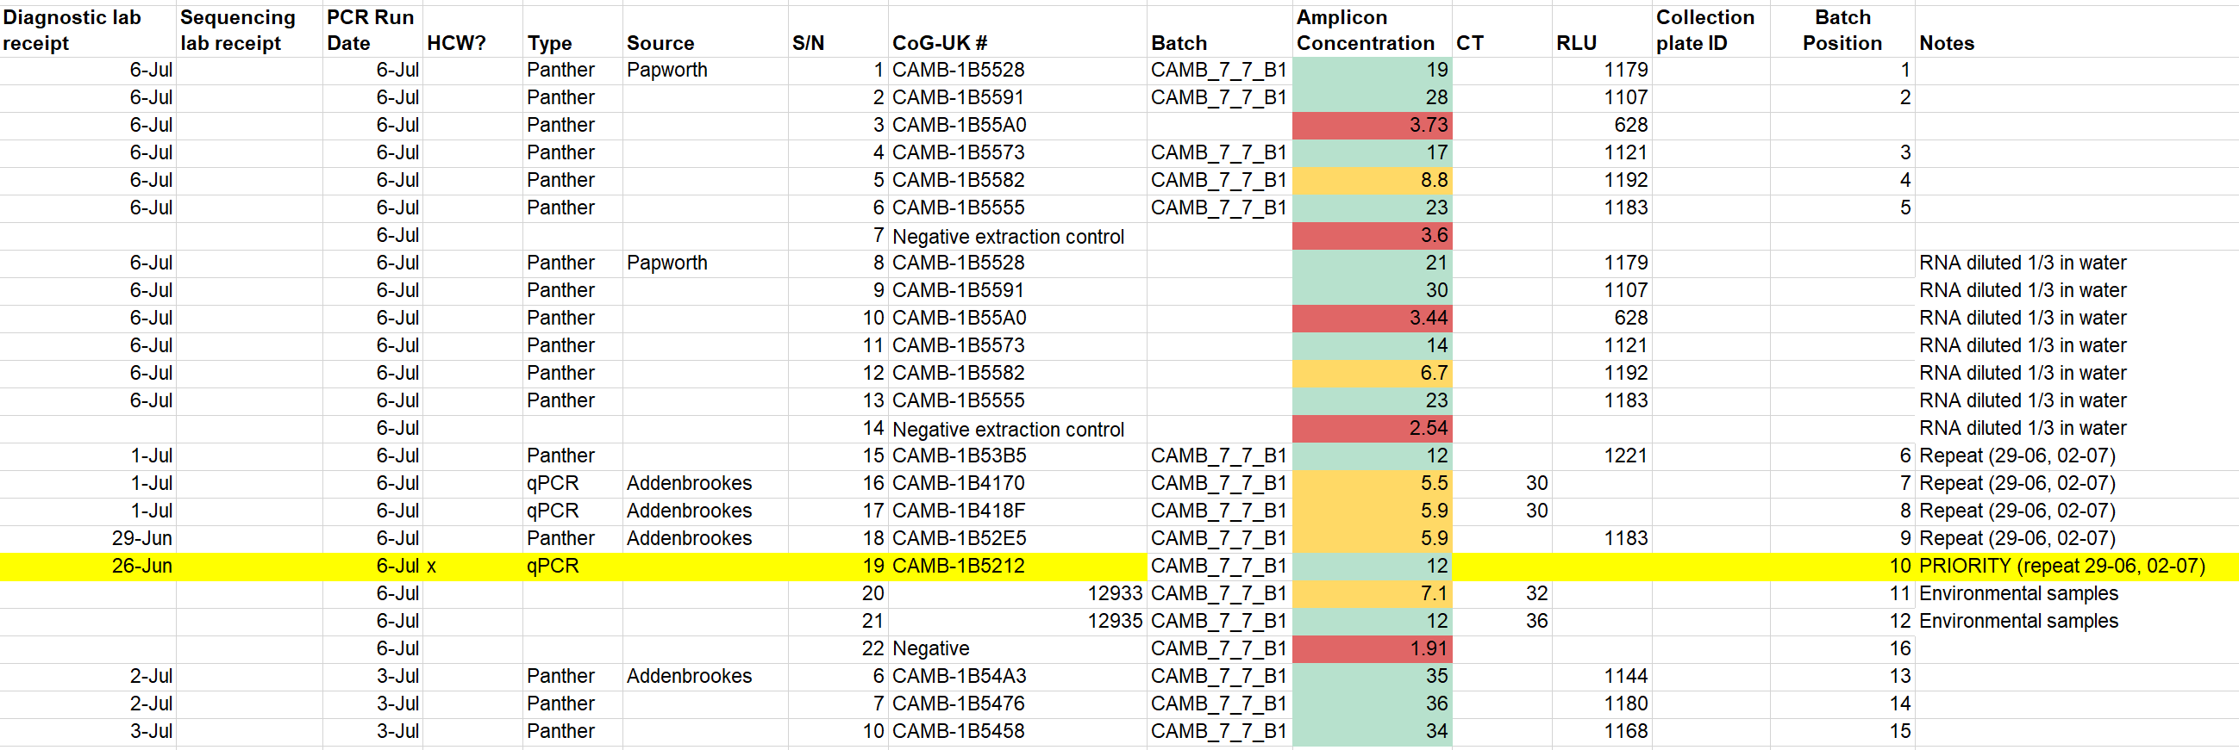
Sample management
-Regularly update metadata
Notes:
Here is an example of what this could look like….

Slide 6
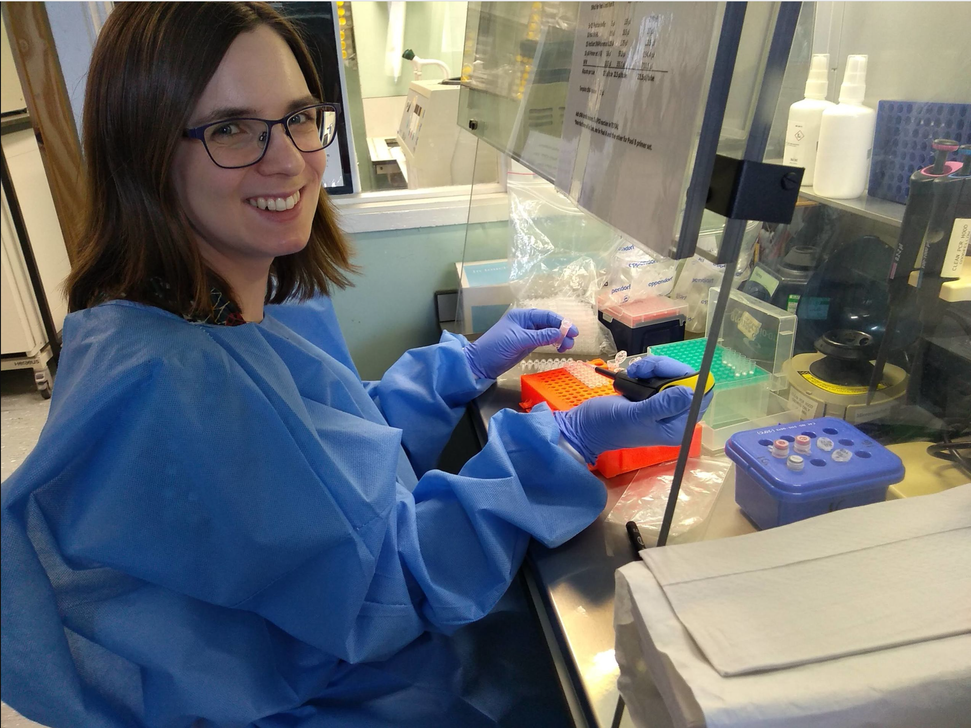
RNA extraction
-Spin down swab tubes
-Extract from swab aliquot, reserve residual
-Decontaminate between samples
-Directional extraction
-Essential negative control inclusion per extraction batch
-Elute in low bind tubes
-RNA sample labelling consistency
-Appropriate RNA storage (+4, -20)
Notes:
After meeting all mentioned criteria…
Minimising contamination is essential
Decontaminate between samples-pipettes between ach, gloves every few samples-bleach and ethanol
Directional extraction-eg left to right….
RNA sample storage (prevent degradation)

Slide 7
RNA for downstream processing-QC
-Cold storage essential
-Total RNA concentration check alongside negative control
-Troubleshooting steps
Notes:
Again, to empathise the importance of cold chain storage, transfer etc to prevent degradation of RNA
Total RNA conc/nanodrop (not indicative, but quick check to ensure neg ex is clean, total RNA not lost-later QC will pick this up)
If contamination experienced, perform a deep clean of pipettes, lab coats, working space and repeat extractions

Slide 8
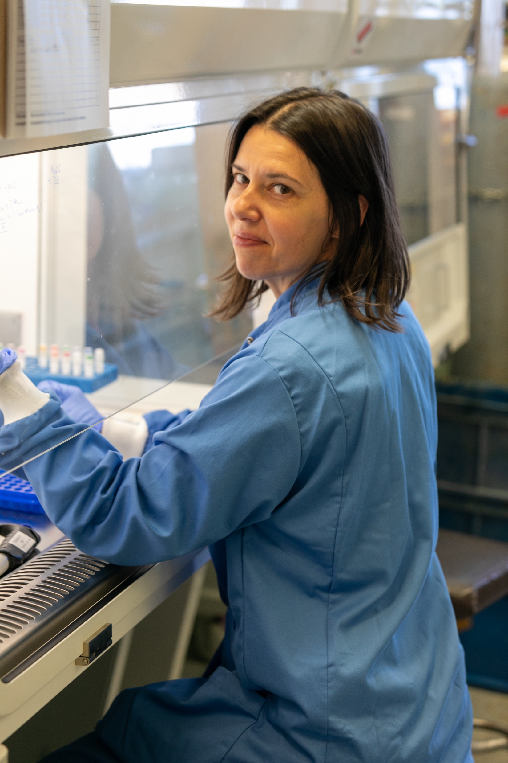
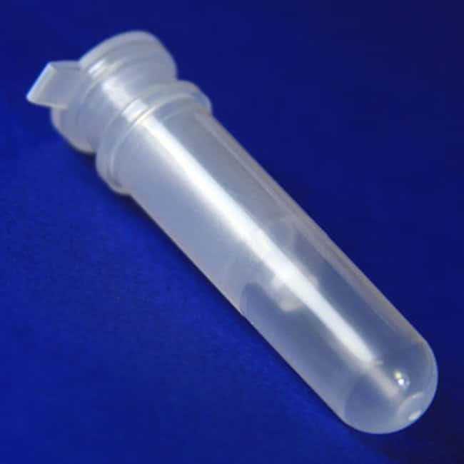
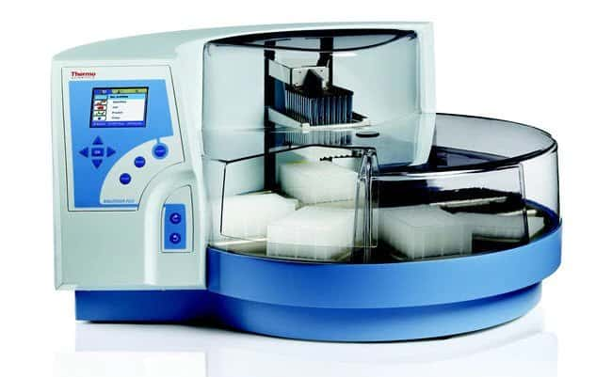
Options for RNA extraction
-Consider Pros Cons:
-Cost effective
-Speed versus quality
-Availability
-Sample batch handling (>12)
Notes:
Availability-e.g. homemade buffers
Silica columns quick, reproducible…(kits)
Trizol-complex waste management and risk assessments required

Slide 9
